Slide 1
Solving Memory Leaks

Slide 2


Slide 3
Memory Leak
A memory leak occurs when memory that has been allocated and is no longer needed does not get released.

Slide 4
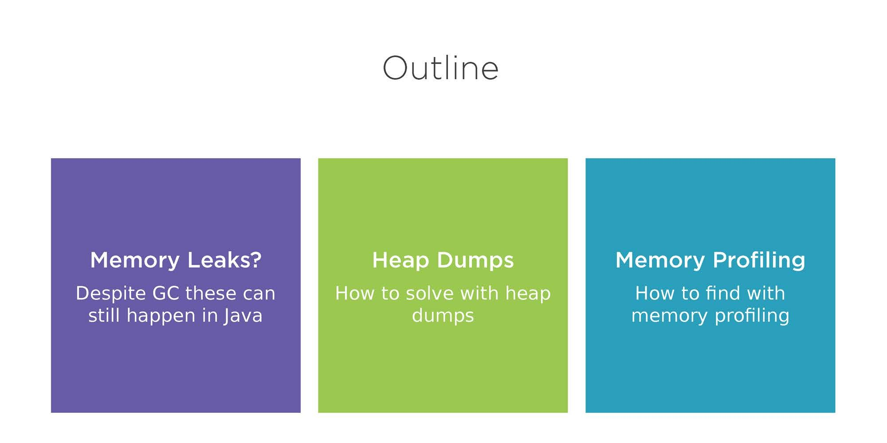

Slide 5
Memory Leaks?

Slide 6
Memory Leak
A memory leak occurs when memory that has been allocated and is no longer needed does not get
released.

Slide 7
Public void foo() {
Object obj = new Object ();
//Method ends here
}
Allocation
Calls new() allocate memory

Slide 8
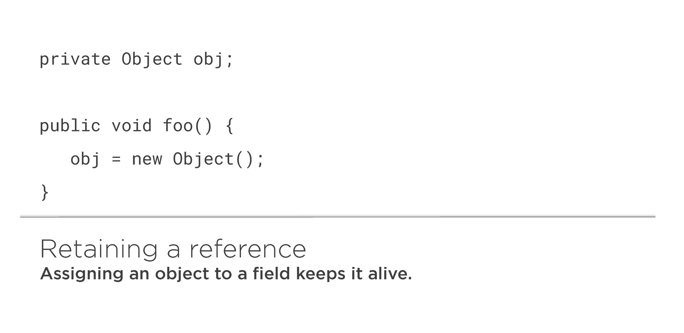

Slide 9
Garbage Collection does not prevent all memory leaks.

Slide 10
Heap Dumps

Slide 11
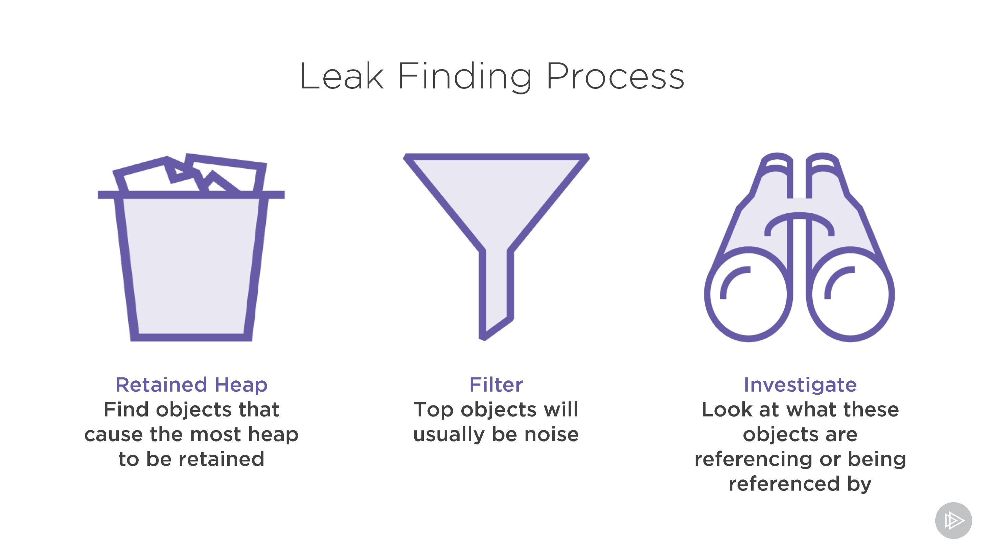

Slide 12

Demo
Books is a Spring Boot application
We’ll fix a memory leak in it Using a heap dump

Slide 13
Memory Profiling

Slide 14


Slide 15
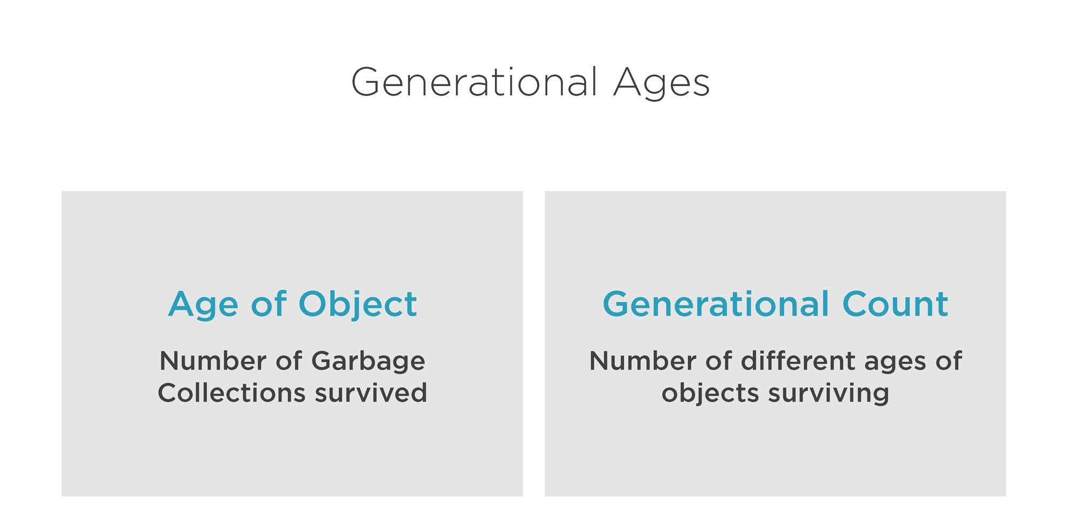

Slide 16
Demo
We’ll fix a similar memory leak
This time in a simpler and more cut down application
Using it to illustrate the memory profiling approach

Slide 17
Conclusions

Slide 18

Summary
Memory can leak despite Garbage Collection
Find the unused references and break them.
They can be found using both memory profiling and heap dumps

